Slide 1
GNS3

Slide 2
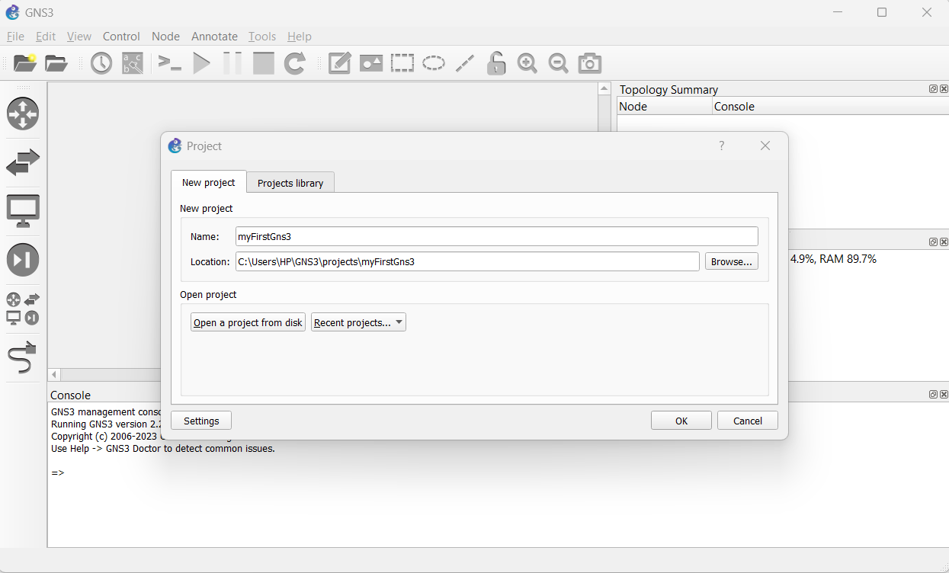
After installation, Create a Project

Slide 3
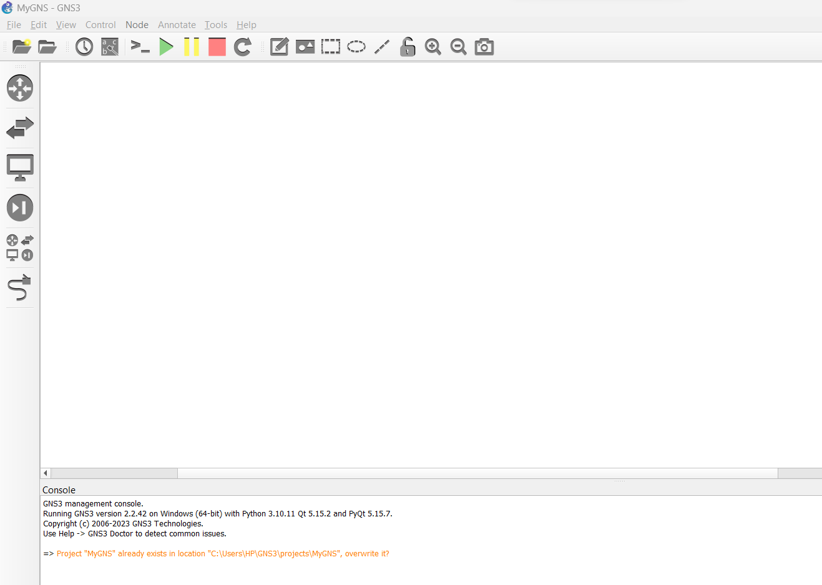
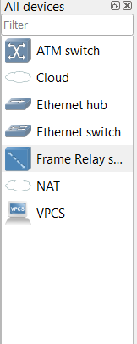
Steps
1. Drag and Drop two VPCS
2. Drag and Drop one Ethernet Switch
3. Write click on VPCS
5. select change symbol
6. click affinity-circle-blue
7. Select client symbol
Click Here

Slide 4
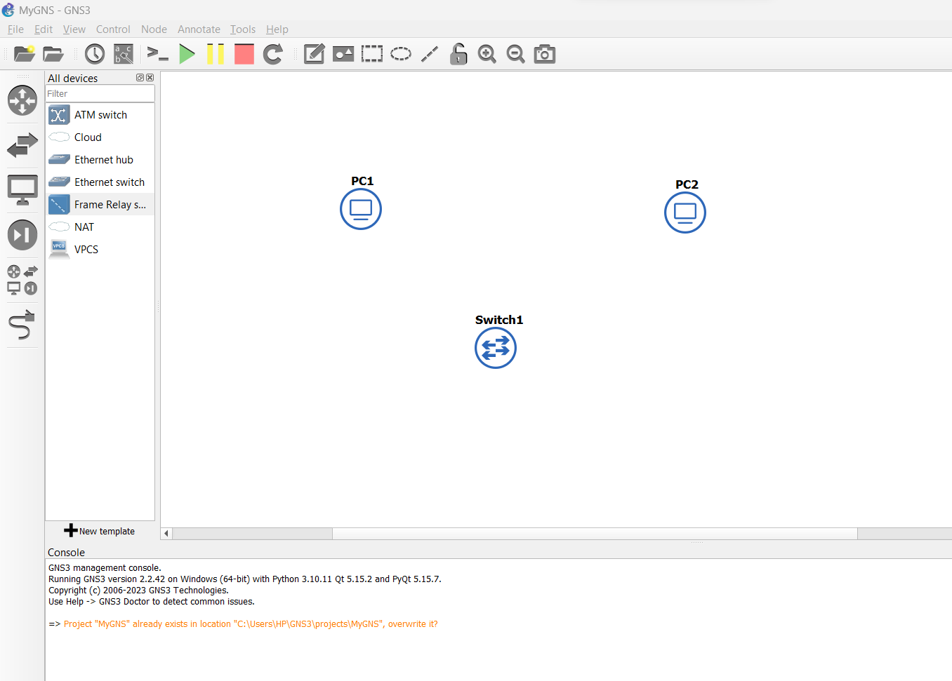
Click here

Slide 5
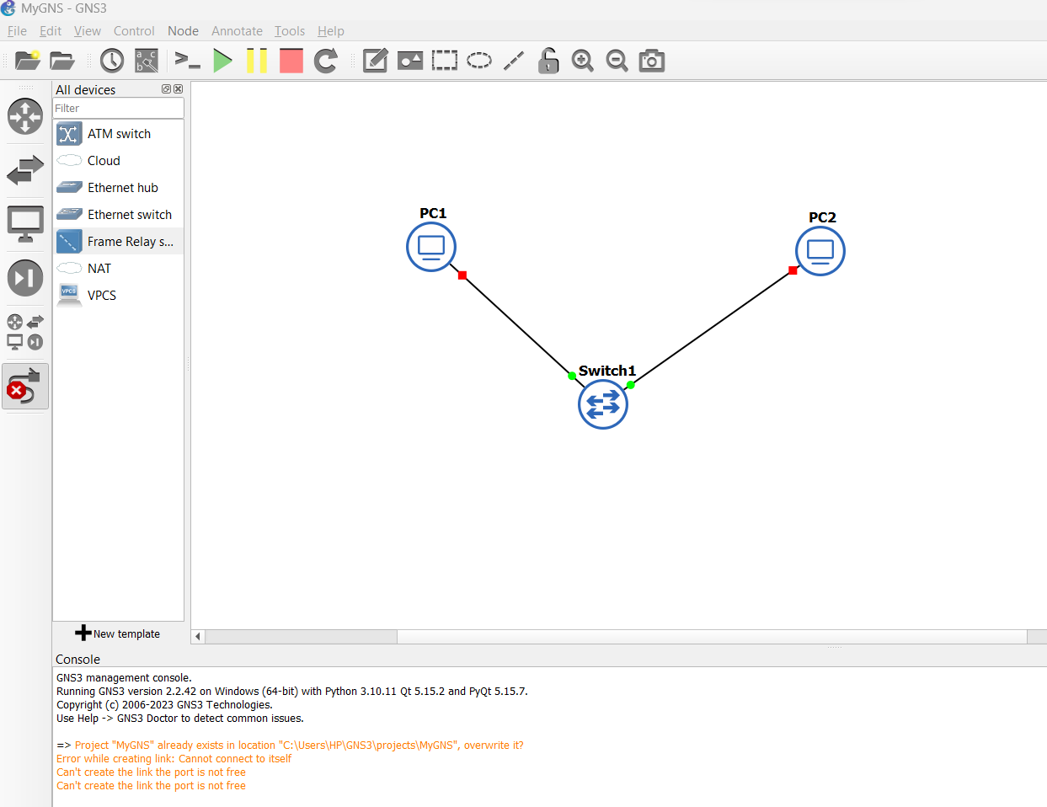
Click and drag ethernet from pc1 to switch1 , and from switch1 to pc2
Click on labels
Click on start
Right click pc1 and click console
also pc2

Slide 6
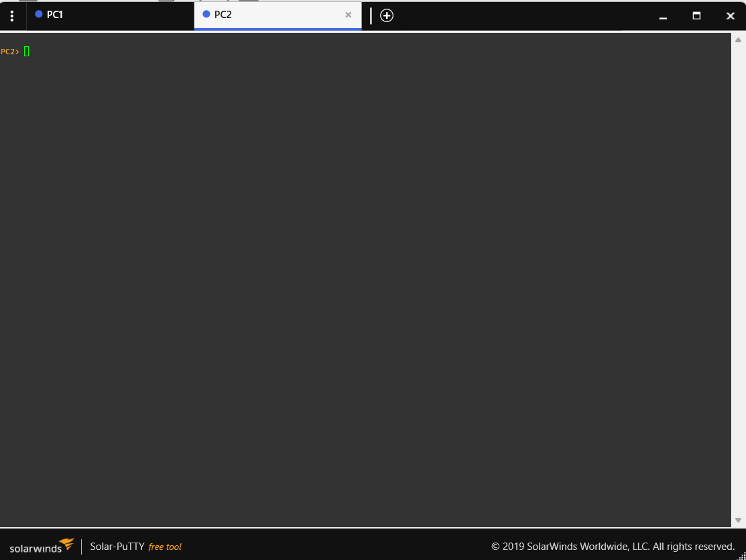

Slide 7
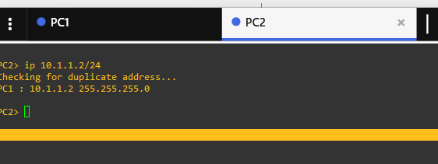

Slide 8
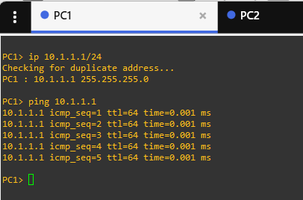

Slide 9
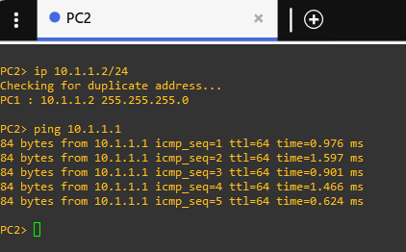
Close both putty console

Slide 11
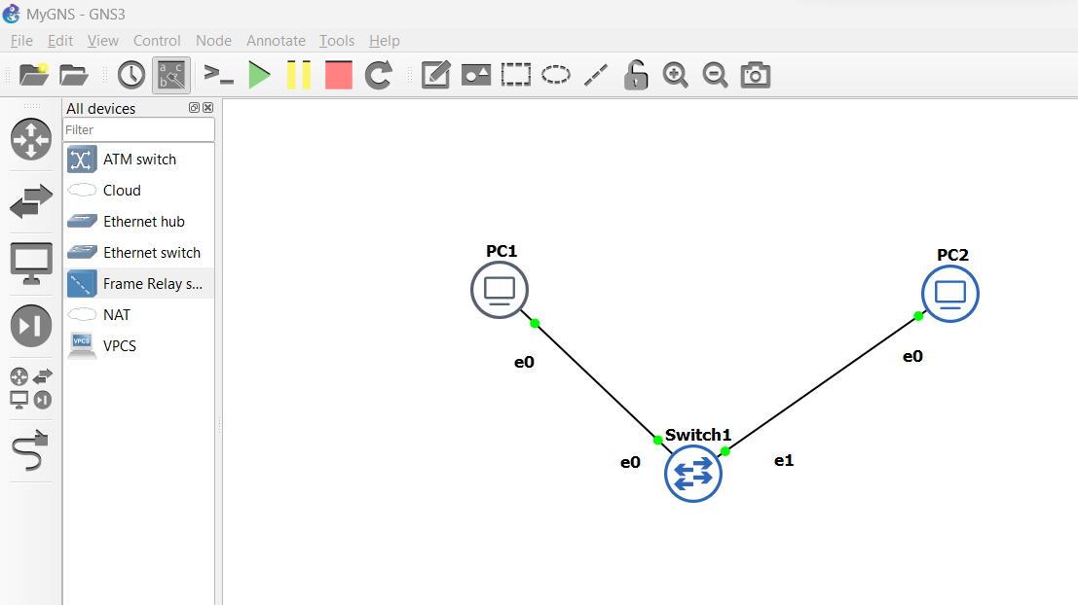
Click Stop

